Slide 1
Theory of Automata and Formal Language Lecture-35 Dharmendra Kumar (Associate Professor) Department of Computer Science and Engineering United College of Engineering and Research, Prayagraj March 30, 2021

Slide 2
Construction of TM
In this section, we shall see how TM’s can be constructed.
Ex. Construct TM for the following languages:-
L = { 0^{m}1^{n} ! m, n ≥ 1}
L= the set of all strings of 0 and 1 which contain 001 as a substring.
L= the set of all strings of 0 and 1 ending with 101.
L= the set of strings of a and b which contains at least one a’s and exactly two b’s.

Slide 3
Ex. L = { 0^{m}1^{n} ! m, n ≥ 1}
Solution:
Procedure: First check given language is regular or not. If language is regular then first construct DFA for that language. After, convert it into TM.
Since this language is regular, Therefore the TM for this language will be
(1,1,R)
(0, 0 ,R)
(0, 0 ,R)
(1, 1 ,R)
q₀
q₁
q₂

Slide 4
Ex. L= the set of all strings of 0 and 1 which contain 001 as a substring.
Solution:
Since this language is regular, therefore the TM for this language is
(1, 1, R)
(0, 0, R)
(1, 1 , R)
(0, 0, R)
(1, 1, R)
(0, 0 , R)
(0, 0 , R)
(1, 1, R)
q₀
q₁
q₂
q₃

Slide 5
Ex. Construct Turing machine for the language L = { 0^{n}1^{n} ! n ≥ 1 }.
Solution:
To construct Turing for a language, first we have to identify the pattern of strings belongs in to L. Some strings are 01, 0011, 000111 etc.
Now, you have to think, how machine move from initial ID to final ID.
Procedure: Initially machine starts at the initial state q₀. machine scan the tape string. If the current tape symbol is 0, then machine change its state, replace the current input symbol 0 by another tape symbol and also the head of machine move in the right direction.
Machine move in the right direction until 1 appears in the tape. As soon as 1 appears in the tape, machine replaces 1 by some another tape symbol, return to back i.e. move in the left direction and change its state.

Slide 6
L = { 0^{n}1^{n} ! n ≥ 1 }
Machine move in the left direction till leftmost 0 appears in tape. As soon as, machine be reached at leftmost 0, its state becomes q₀.
we repeat the whole process till any 0 in the tape. As soon as, all 0’s are deleted from tape, we check number of 1’s in tape. If there is any 1’s in the tape, then machine reject the string otherwise machine may accept the string.
Therefore, the TM corresponding to this language will be
M=( {q₀,q₁,q₂,q₃, q₄}, {0, 1}, {0, 1, x, y, B}, q₀, B, {q₄})

Slide 7
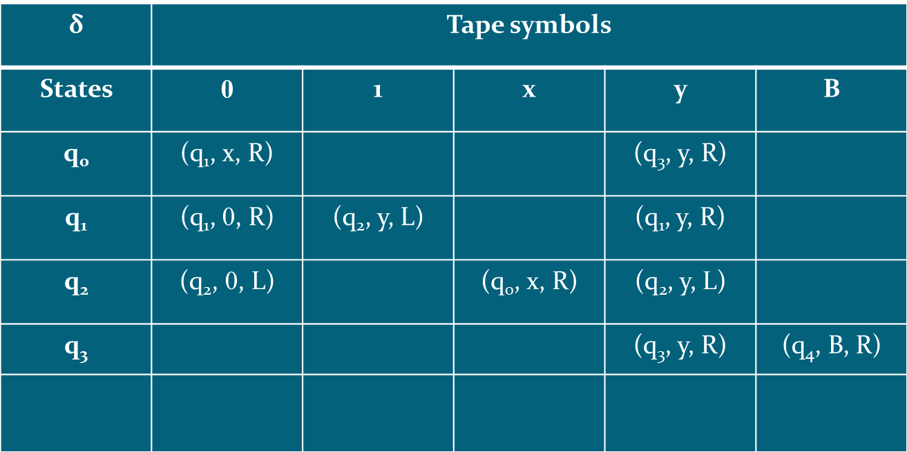
L = { 0^{n}1^{n} ! n ≥ 1 }
Transition table is
q₄

Slide 8
L = { 0^{n}1^{n} ! n ≥ 1 }
Transition diagram is
(0, 0 ,L)
(y, y, L)
(0, 0 ,R)
(y, y, R)
(0, x ,R)
(1, y ,L)
q₀
q₁
q₂
(y, y, R)
(x, x ,R)
(B, B ,R)
q₃
q₄
(y, y, R)

Slide 9
Processing and Verification of TM
Acceptance
Consider string w = 0011 .
q₀0011 ⊢ xq₁011 ⊢ x0q₁11 ⊢ xq₂0y1 ⊢ q₂x0y1 ⊢ xq₀0y1 ⊢ xxq₁y1 ⊢ xxyq₁1 ⊢ xxq₂yy ⊢ xq₂xyy ⊢ xxq₀yy ⊢ xxyq₃y ⊢ xxyyq₃B ⊢ xxyyBq₄B (machine halts at final state)
Since machine halts at final state, therefore this string is accepted by TM.
Rejection
Consider string w = 011 .
q₀011 ⊢ xq₁11 ⊢ q₂xy1 ⊢ xq₀y1 ⊢ xyq₃1 (machine halts at non-final state)
Since machine halts at non-final state, therefore this string is not accepted by TM.

